Slide 1

IPL DATABASE ANALYSIS

Slide 2
IPL Database Analysis
Using PostgreSql
By:
R Rahul
20NR1A0595
CSE-4B

Slide 3

Quick Facts:
Indian Premier League known for ipl, a professional Twenty20 cricket league in India contested during April and May of every year by teams representing Indian Cities
It’s Inaugural season started in the year 2008
It’ It is founded by BCCI and it is now the most attended cricket league in the world and ranks sixth (6th) among all sports league
In 2010, the IPL became the first sporting event in the world to be broadcasted live on YouTube

Slide 4
Introduction:
Ipl Database Analysis using Postgresql
Objective:
Using different Sql functions to Analyze ball-by-ball data for all the IPL cricket matches played
between 2008 & 2020 using Postgresql
Tools :
pgAdmin 4
Psql shell
MS Word
MS Excel

Slide 5
Postgresql:
An open source advanced object-relational database management system allows you to
store, process & retrieve data safely & efficiently
It is the 4th most widely used & popular database in the world
History:
1977 – INGRES was developed
1986 – Michael Stonebraker led the POSTGRES
1987 – Demo version was released
1994 – SQL interpreter was added

Slide 6
Features:
Open source & free to download
Supports variable Operating Systems like Windows, Mac & Linux
Highly secure & reliable (robust)
Suppports MVCC (Multiversion Concurrency Control)
ACID Compliance (Atomicity, Consistency, Isolation & Durability)
Applications:
It supports Amazon, Google & Microsoft Cloud services
Companies using Postgresql:
Instagram
Netflix
Uber…

Slide 7
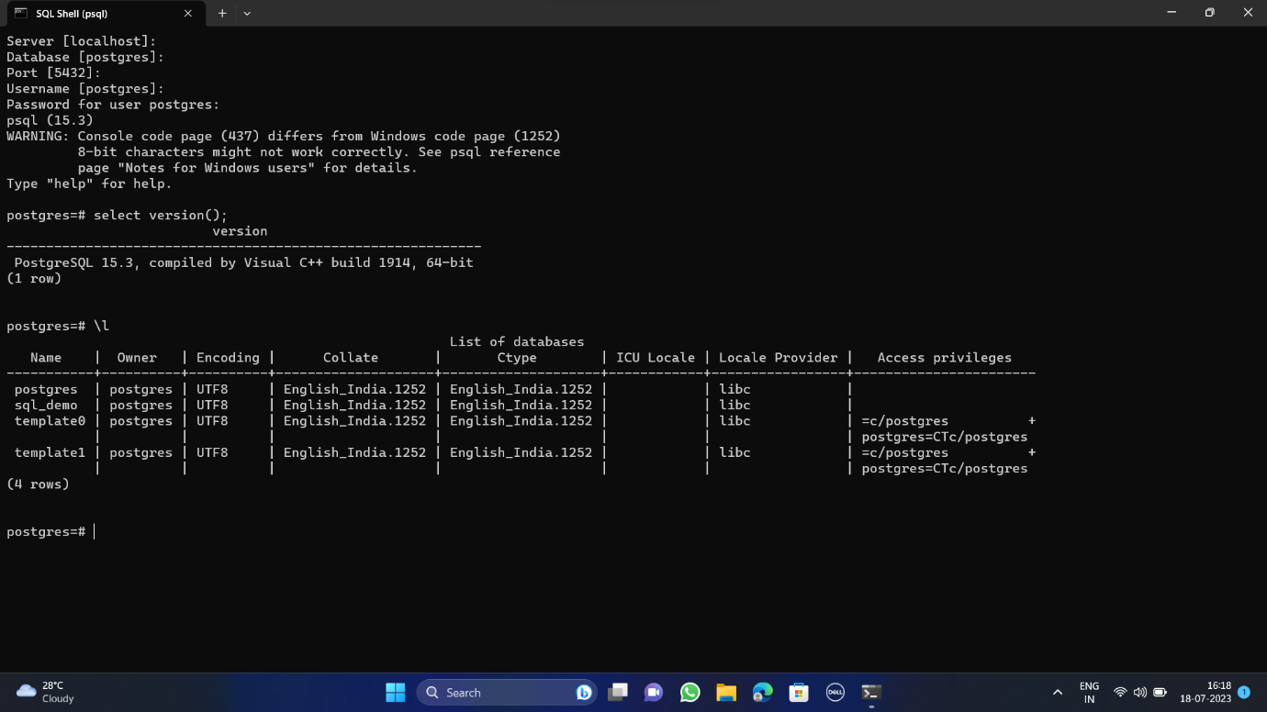
PSql Shell
Psql Shell where we can host & write commands and run the queries

Slide 8
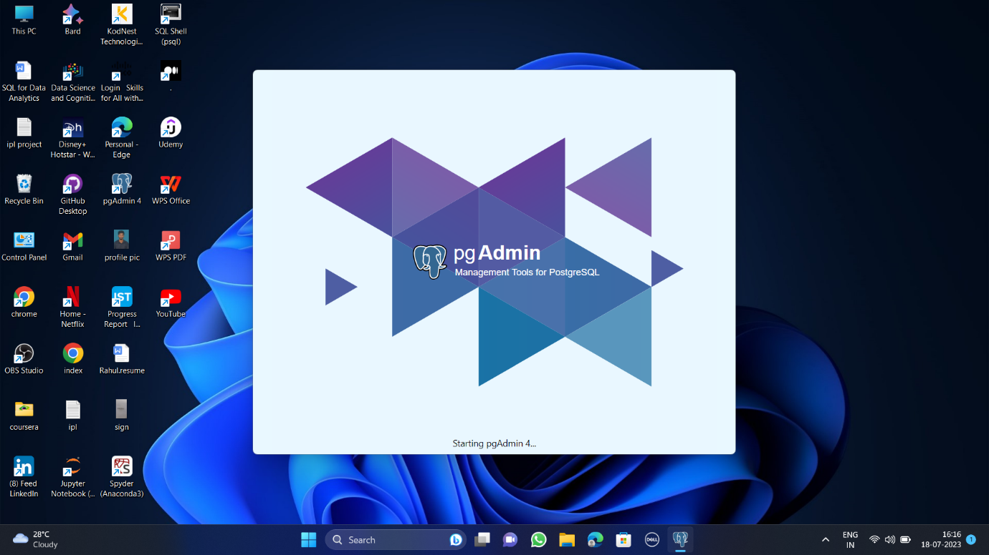
pgAdmin 4
pgAdmin 4 where we can create tables & run the queries

Slide 9
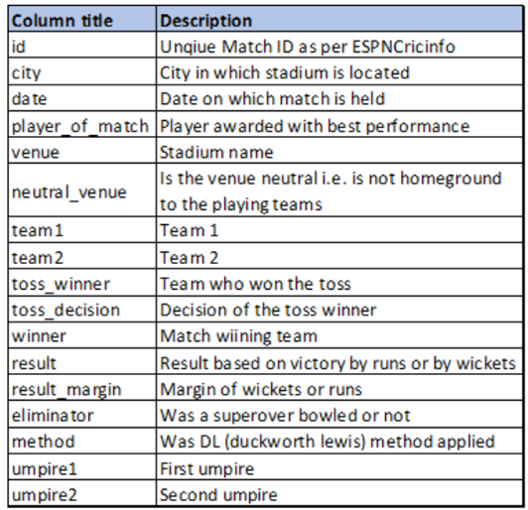
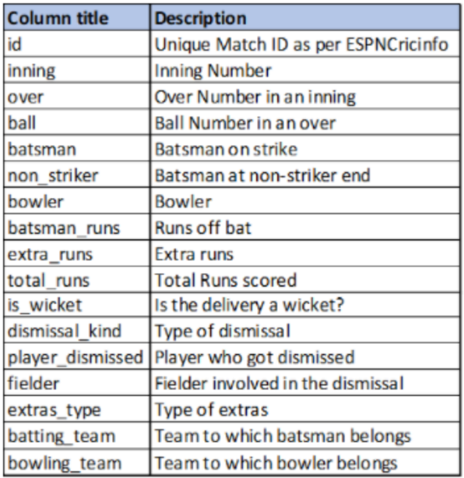
Data Consists:
This below CSV file contains match-wise data & has data of 816 IPL matches. This table has 17 columns & below is the description of the columns in the table
This CSV file contains ball-by-ball data & it has info. Of all the 193468 balls between the years 2008 & 2020. It has 17 columns & below is the 17 columns

Slide 10
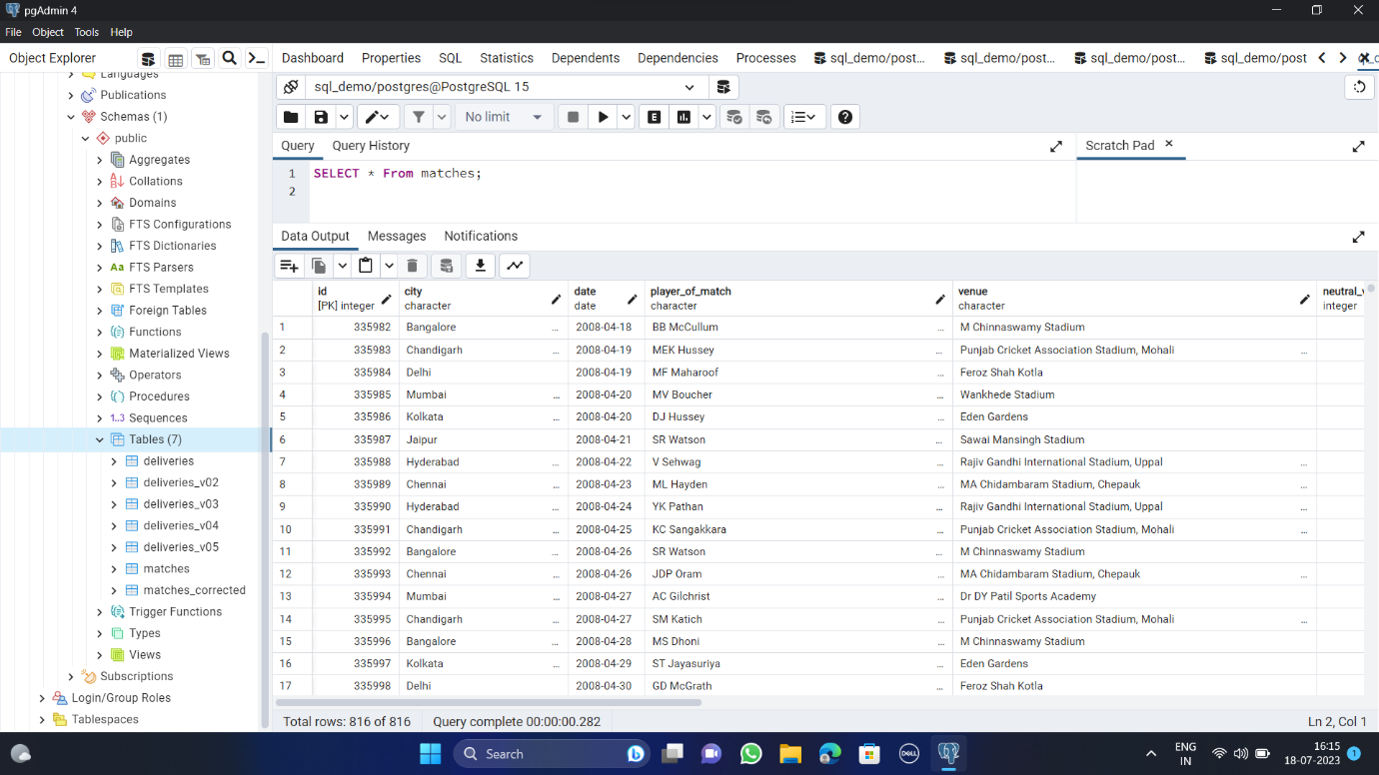
pgAdmin-4 Interface

Slide 11
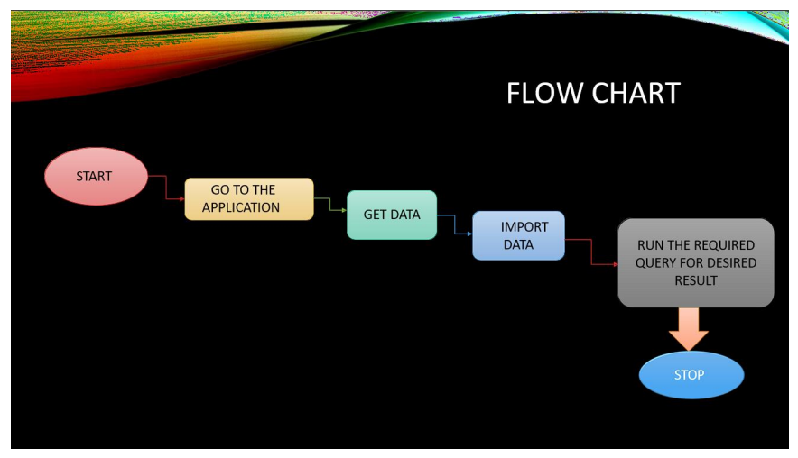
Flowchart

Slide 12
Conclusion:
By analyzing the data, we come into last step is conclusions. Conclusions summarize whether the experiment or our survey results support or contradict the original hypothesis. We should include key facts from our background research to help explain the results.

Slide 13
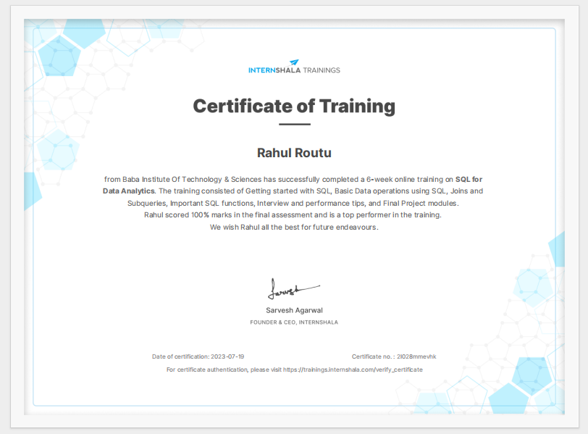
Certificate

Slide 14
Thank You

